Slide 1
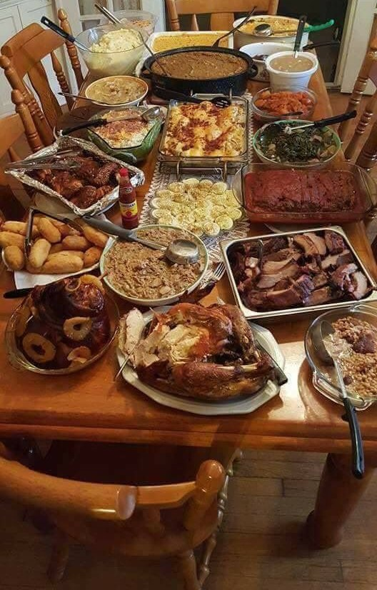
CALVARY HILL CHURCH, NASHVILLE
Spring Fundraiser
2027
Saturday, February 21, 2027 | 5:30 PM
Calvary Hill Fellowship Hall
An evening of dinner, music, and giving

Slide 2
The Evening
Fellowship, a Southern dinner, and support for ministry
🍽
🎵
🎁
Southern Buffet
Choir Performance
Auction and Raffle
A full home style dinner for 200 guests
A featured set led by the baritone section
20 donated items and a 300 ticket raffle
Last year our spring dinner raised $11,840 net for the ministry. This year, with higher ticket capacity and a confirmed corporate sponsor, we are projecting $13,195, an eleven percent increase.

Slide 3
Projected Income
Six sources totaling $20,150
Source | Amount
Ticket sales, 180 plates | $8,100
Silent auction | $4,500
Raffle | $3,000
Member donations | $2,200
Corporate sponsor | $1,500
Bake sale | $850
Total income | $20,150

Slide 4
Year Over Year
2025 result versus the 2027 projection
• More plates. Ticket capacity up to 180 guests.
• New sponsor. A confirmed corporate sponsor at $1,500.
• Lean costs. Expenses held near 35 percent of income.
• Bigger impact. $1,355 more for ministry than last year.

Slide 5
The Committee
Volunteers who make the night happen
Name | Role | Availability
Carlos Moore | Committee Chair | All day
Pastor James Whitfield | Spiritual Lead and Emcee | Afternoon and evening
Maria Moore | Food Committee Co-Lead | Morning and evening
Marcus Webb | Silent Auction Manager | Afternoon and evening
Sister Gloria Watkins | Bake Sale Coordinator | All day
Tamara Collins | Choir and Entertainment | Afternoon
Brenda Coles | Cash Box and Finance | All day

Slide 6
Be part of the night.
Reserve a plate, sponsor a table, or donate to the ministry fund.
Every dollar stays in Nashville and serves our community.
Carlos Moore, Committee Chair | Calvary Hill Church

